Slide 1
Process Concept

Slide 2
Program, Process, Processor
A progam is a set of instructions. A process is a program in execution. It is a unit of work within the system. Program is a passive entity, process is an active entity.
Processor is the device which executes programs.
Process needs resources to accomplish its task
CPU, memory, I/O, files
Initialization data
Process termination requires reclaim of any reusable resources

Slide 3
Threads
A thread is predefined instance of a process. A thread performs a specific function. A process may consist a set of threads
Single-threaded process has one program counter specifying location of next instruction to execute
Process executes instructions sequentially, one at a time, until completion
Multi-threaded process has one program counter per thread
Typically system has many processes, some user, some operating system running concurrently on one or more CPUs
Concurrency by multiplexing the CPUs among the processes / threads

Slide 4
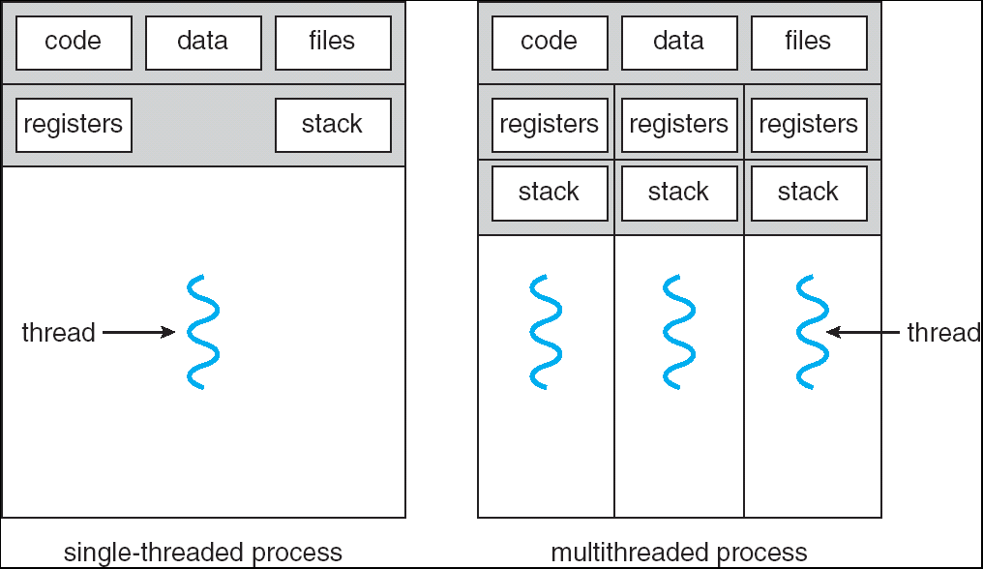
Single and Multithreaded Processes

Slide 5
Process Management Activities
The operating system is responsible for the following activities in connection with process management:
Creating and deleting both user and system processes
Suspending and resuming processes
Providing mechanisms for process synchronization
Providing mechanisms for process communication
Providing mechanisms for deadlock handling

Slide 6
Process Creation
System Initialization – Boots up
User related events – click, double click, drag
Execution of a function call- process creates a child process

Slide 7
Process Termination
System shut down
Process termination – completes execution
Error condition(Voluntary)
Fatal error(Involuntary
Killed by another process

Slide 8
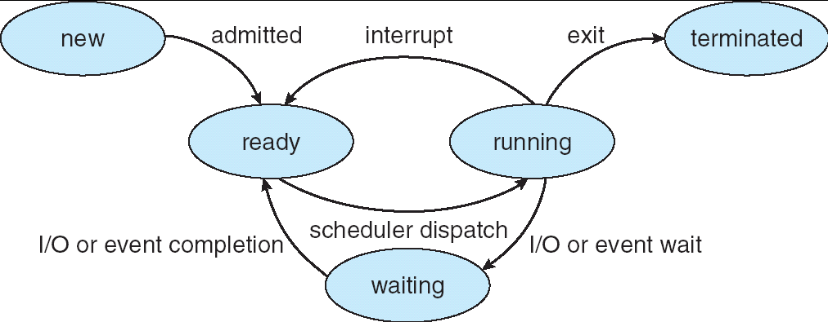
Process States

Slide 9
New – just created, arrived in memory
Ready – prepared for execution once the CPU becomes available
Running – Being executed.
Blocked – has suspended running, requires an I/O device.
Terminated – Has finished executed, prepared to exit memory.

Slide 10
Process Control Block (PCB)
Stores Information associated with each process
Process state
Program counter
CPU registers
CPU scheduling information
Memory-management information
Accounting information
I/O status information

Slide 11
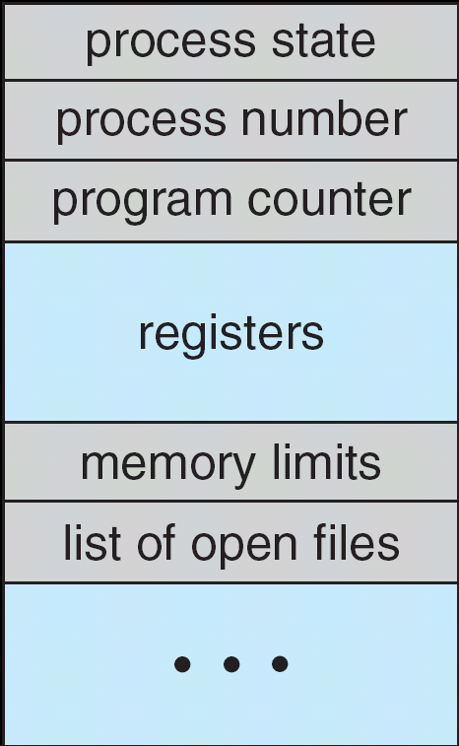
Process Control Block (PCB)

Slide 12
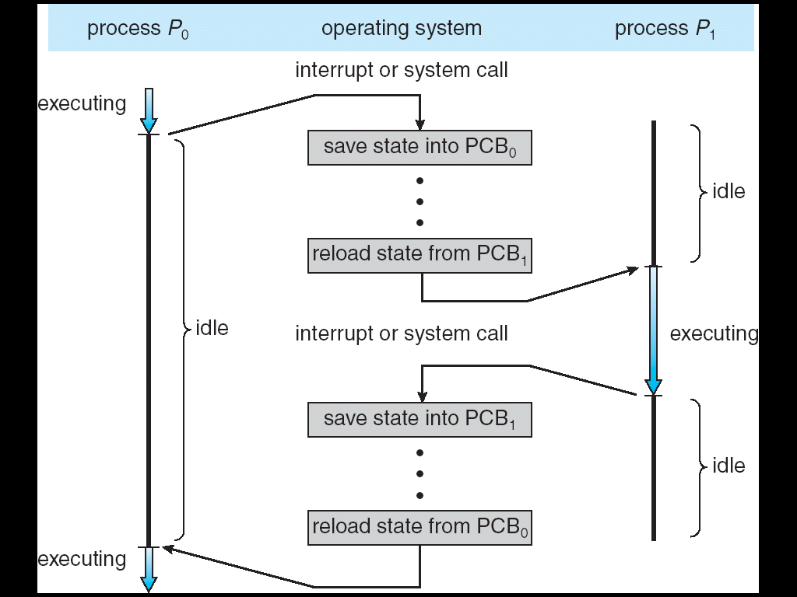
Process Interruption
CPU Switch From Process to Process

Slide 13
Process Scheduling Queues
Ready queue – set of all processes residing in main memory, ready and waiting to execute
Device queues – set of processes waiting for an I/O device
Processes migrate among the various queues

Slide 14
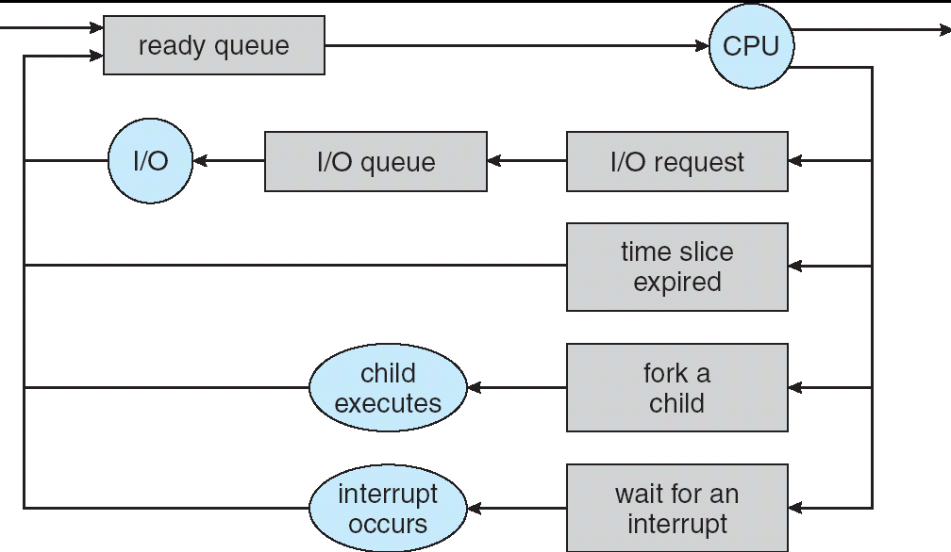
Representation of Process Scheduling

Slide 15
Context Switch
When CPU switches to another process, the system must save the state of the old process and load the saved state for the new process
Context-switch time is overhead; the system does no useful work while switching
Time dependent on hardware support

Slide 16
Process Creation
Parent process create children processes, which, in turn create other processes, forming a tree of processes
Resource sharing may be
Parent and children share all resources
Children share subset of parent’s resources
Parent and child share no resources
Execution mode may be
Parent and children execute concurrently
Parent waits until children terminate

Slide 17
Process Termination
Process executes last statement and asks the operating system to delete it (exit)
Output data from child to parent (via wait)
Process’ resources are deallocated by operating system
Parent may terminate execution of children processes (abort) if
Child has exceeded allocated resources
Task assigned to child is no longer required
If parent is exiting
Some operating system do not allow child to continue if its parent terminates
All children terminated - cascading termination

